Slide 1
Web Scraping and Product Price
Analysis System
Data Analysis Essentials project

Slide 2
Team 04
25B11CS608- M. AKSHAYA(Team lead)
25B11CS710- P. JAGANNADHA VEERA MANIKANTA(Data and Tech Lead)
25B11CS388- K. SAIKRISHNA(Implementation Lead)
25B11CS923- T. YEGHNA SURYA TEJA(Q &A and Strategy Lead)

Slide 3
Introduction
E-commerce platforms contain large amounts of product information.
Product analysis helps compare price, rating, category, and availability.
This project analyzes an e-commerce product dataset.
The dataset was prepared with assistance from Google Gemini.
Python tools were used for cleaning, analysis, and visualization.

Slide 4
Problem Statement
Product data contains multiple attributes that are difficult to compare
manually.
Raw data may contain inconsistent values and different formats.
A structured analysis is needed to identify product patterns.
The project organizes product data and presents the results visually.

Slide 5
Objectives
Analyse an e-commerce product dataset.
Clean and organize product records.
Compare prices, ratings, and categories.
Identify high-rated and low-priced products.
Create charts and tables from the dataset.
Present meaningful product insights.

Slide 6
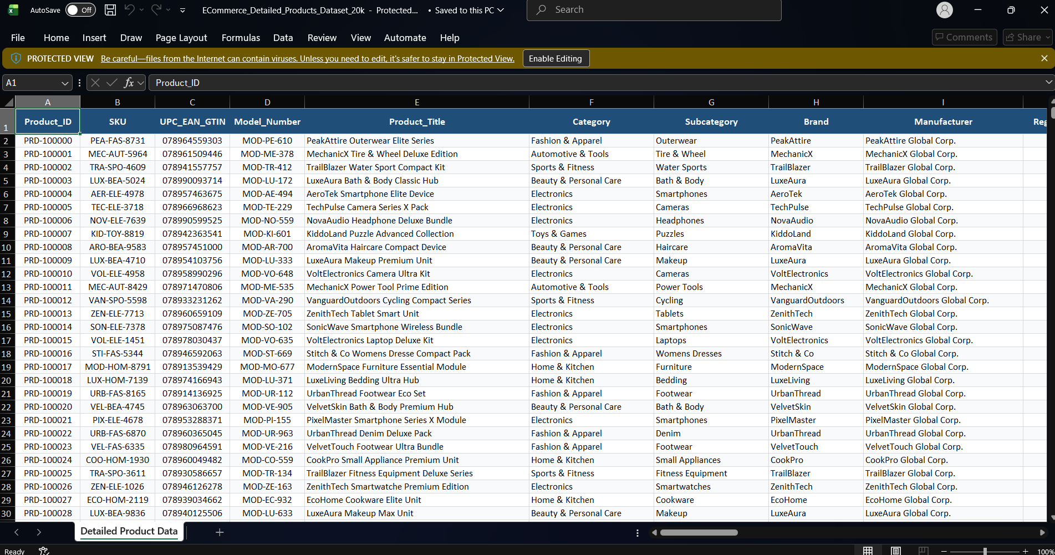
Dataset
Dataset type: AI-assisted synthetic e-commerce dataset.
Dataset source: Google Gemini.
Dataset format: CSV.
Product fields:
  Product name.
  Category.
  Price.
  Rating.
  Availability.
  Brand or seller, if available.
Number of records: 20050 product records(rows)
Dataset limitation: It may not represent real market data.

Slide 7
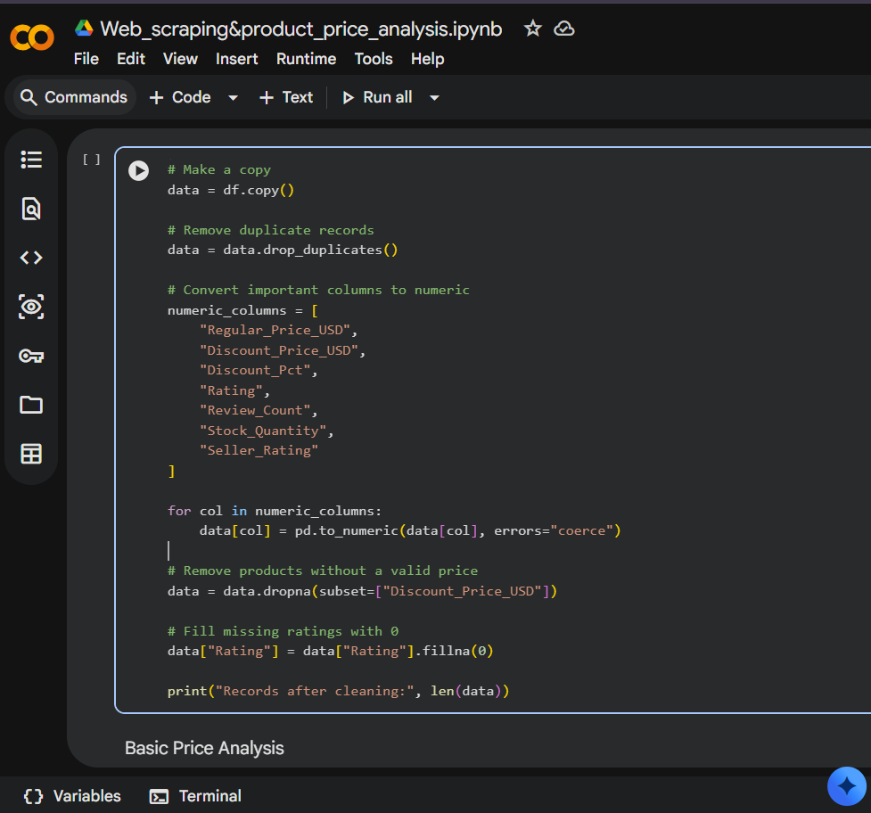
Tools Used
  Python:
    Used for data analysis.
  Pandas:
    Used for loading and cleaning the CSV file.
  Matplotlib:
    Used for creating charts.
  Google Colab:
    Used to run Python code.
  Google Gemini:
    Used to assist with dataset preparation or generation.
  CSV:
    Used to store structured product data.

Slide 8
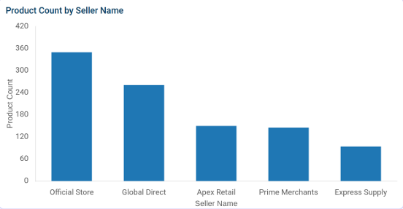
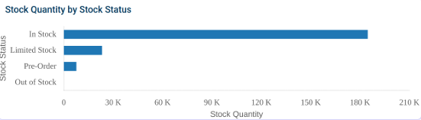
Methodology
Load the CSV dataset.
Inspect columns and data types.
Check missing values and duplicates.
Clean prices, ratings, and categories.
Calculate summary statistics.
Compare products and categories.
Create charts.
Interpret the findings.

Slide 9
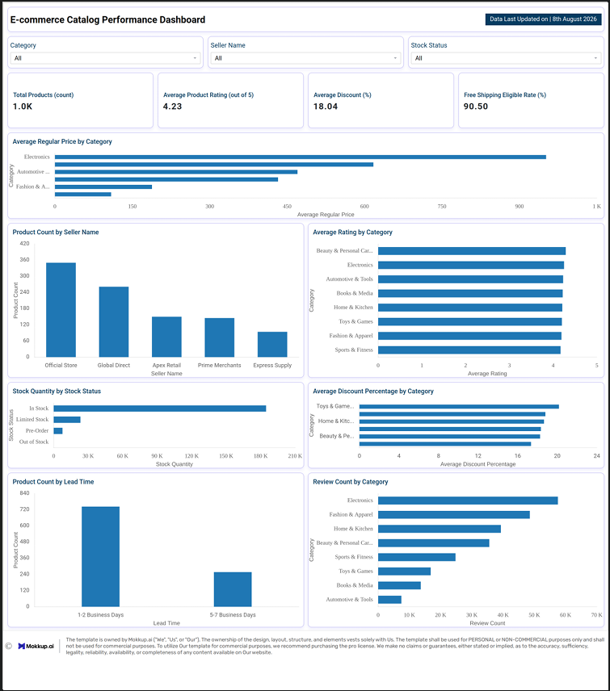
dashboard

Slide 10
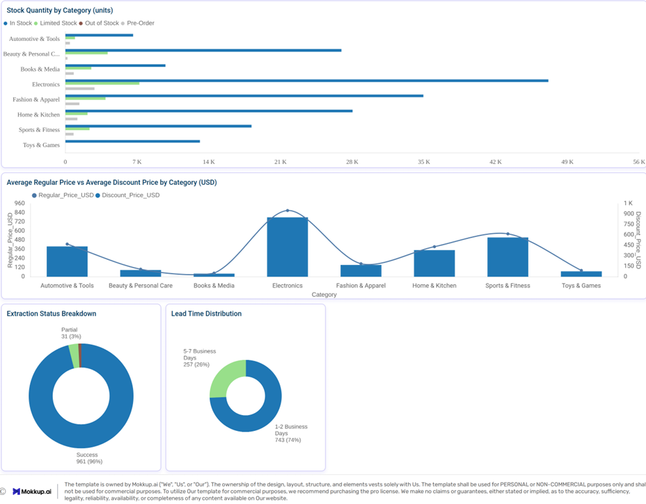
dashboard

Slide 11
Limitations
Some websites may block or restrict requests.
Results depend on the quality of the collected data
Website HTML structure may change.
Some product fields may be missing.
Prices and availability may change over time.

Slide 12
Future Scope
Add more product websites and categories.
Create an interactive dashboard.
Automate daily or weekly data updates.
Add customer review sentiment analysis.
Compare products across multiple platforms.
Add recommendation or price-prediction features.

Slide 13
Conclusion
Product data can be collected automatically using web scraping.
Cleaning makes the data suitable for analysis.
Charts make product comparison easier.
The project converts raw web data into useful insights.
We gained experience in Python, data analysis, visualization, and teamwork.

Slide 14
Thank You

